Slide 1
Predicting the energy output of Wind Turbine based on Weather Conditions
Presented by: Bhavesh Panjwani
Qualification: Bachelor of Engineering (Computer Science)
College: RMD Sinhgad school of engineering, Pune

Slide 2
Introduction:
Wind energy plays an increasing role in the supply of energy worldwide. The energy output of a wind farm is highly dependent on the wind conditions present at its site. If the output can be predicted more accurately, energy suppliers can coordinate the collaborative production of different energy sources more efficiently to avoid costly overproduction.

Slide 3
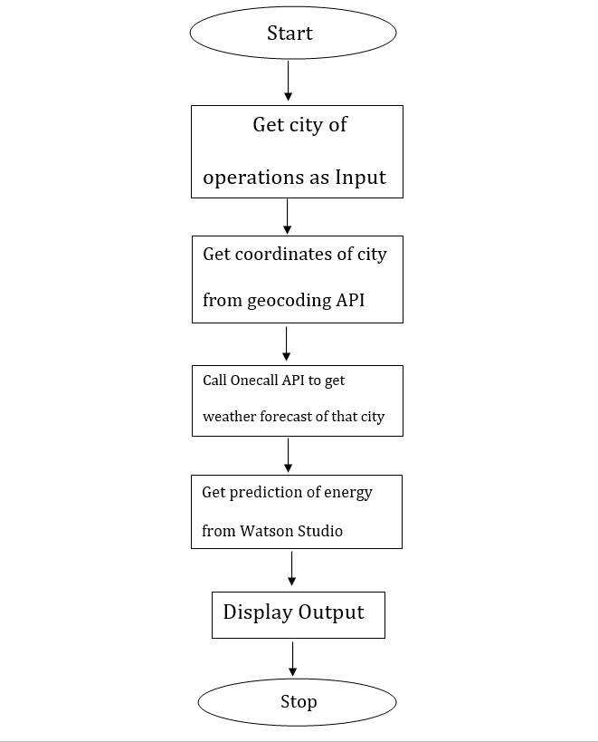
Flowchart:

Slide 4
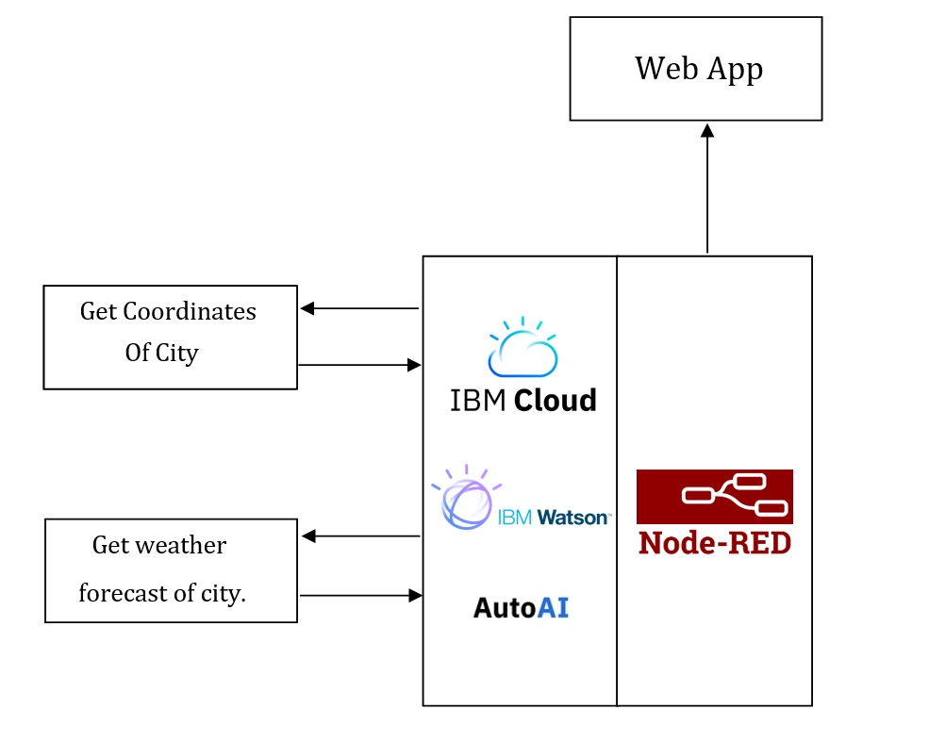
Block Diagram:

Slide 5
Experimental Investigations:
We need to note that the minimum wind speed which is needed to operate is 3 meter/seconds. And the maximum speed of wind in which wind turbine can operate is 25 meter/seconds.
The height of hub of wind turbine also affects the output of wind turbine. Every 10 m increase in tower height means wind speeds are 2% to 3% stronger, yielding 3% to 5% more energy.
The accommodation of larger rotors produces more energy.
Also there are other factors like humidity which affect the output of wind turbine.

Slide 6
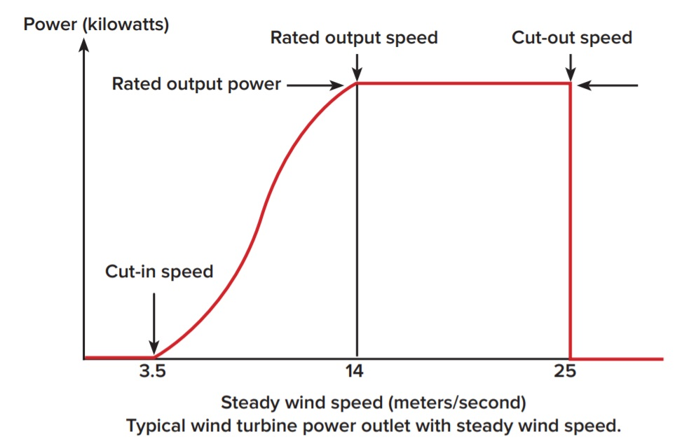

Slide 7
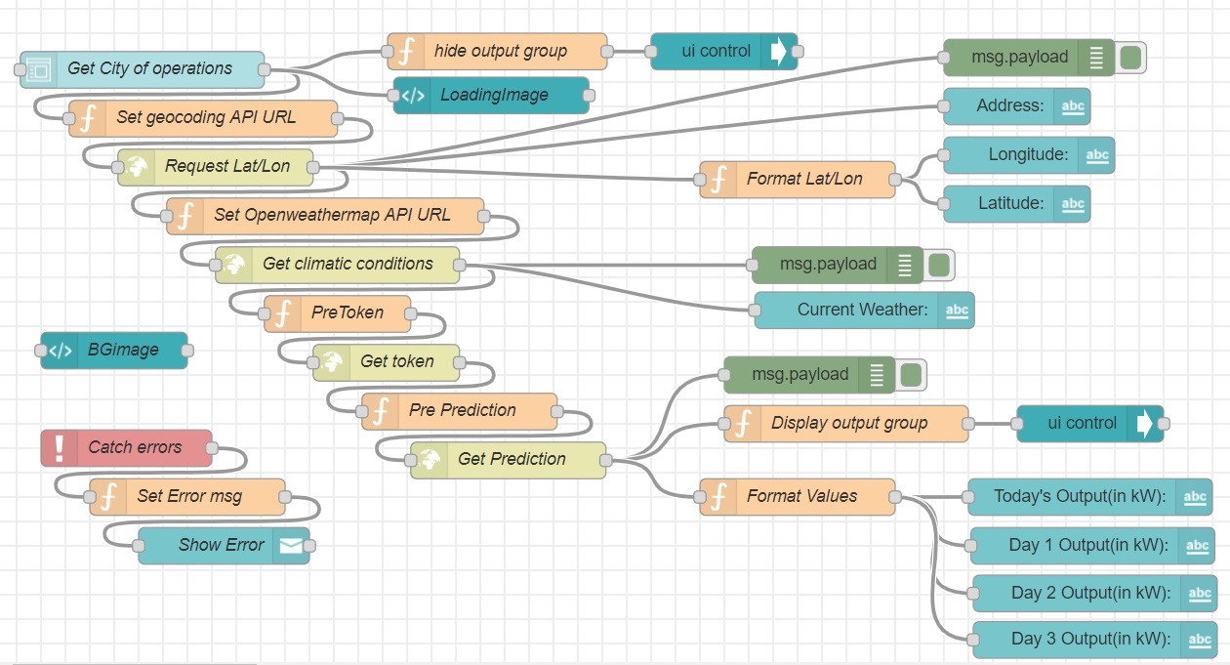
Actual Implementation:

Slide 8
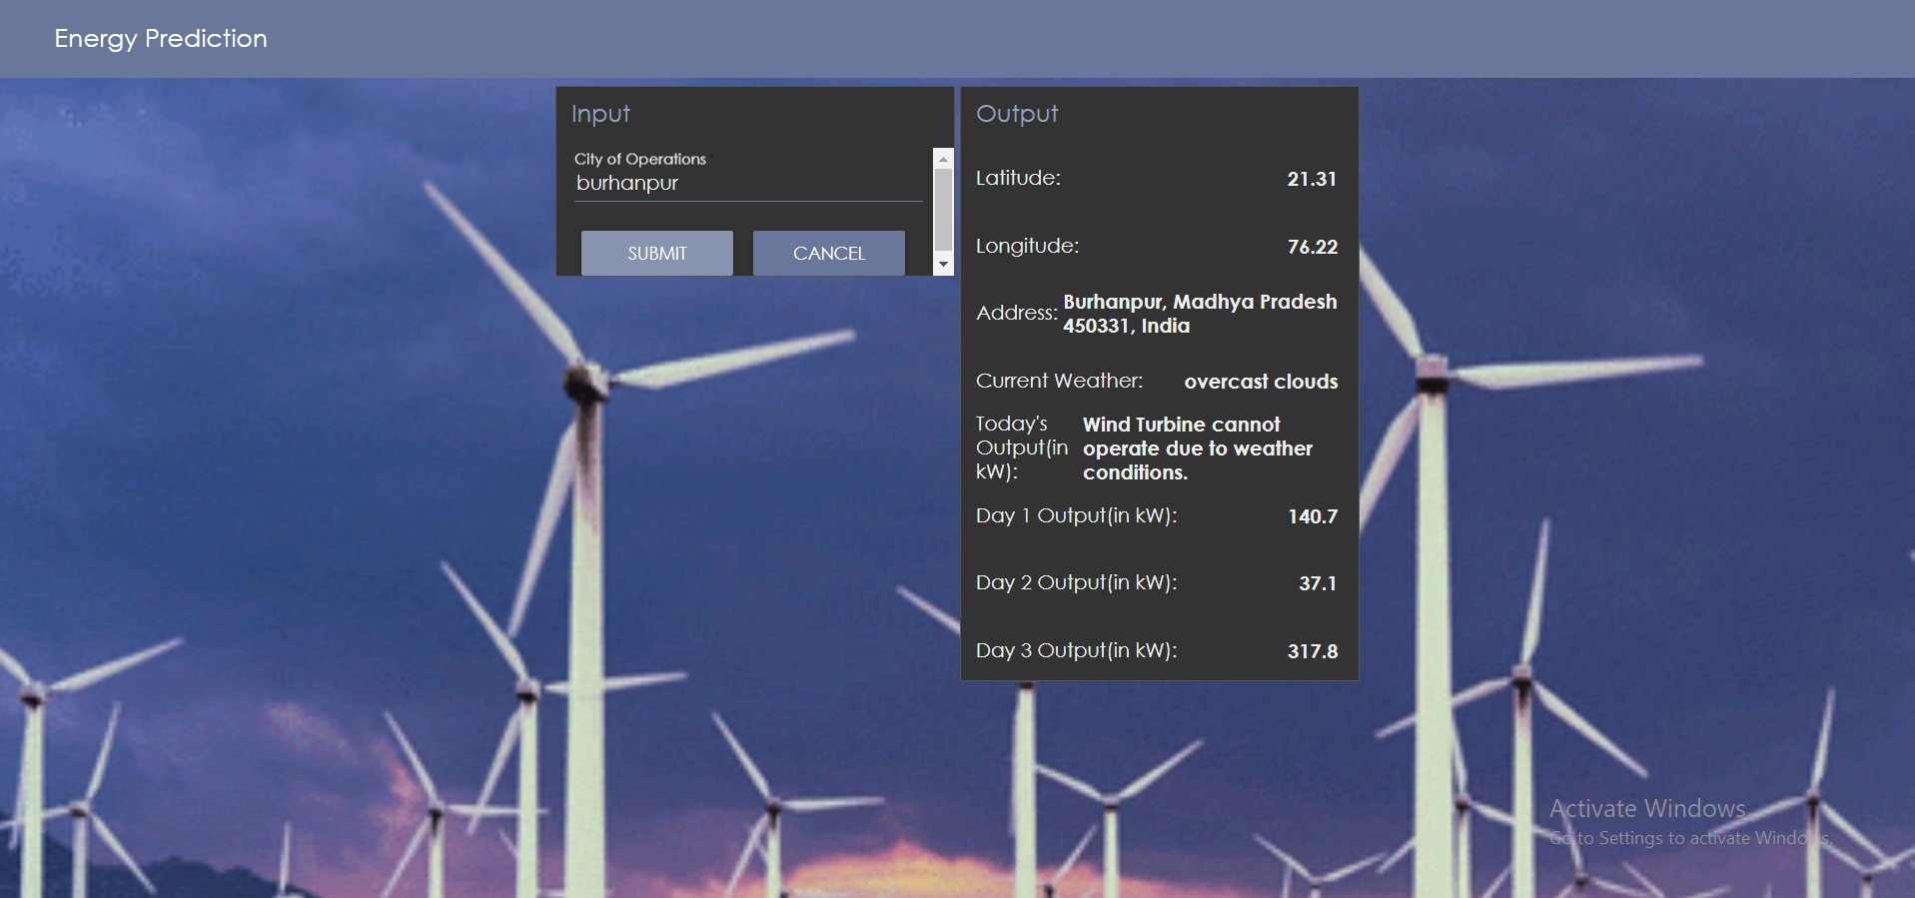

Slide 9
Thank You

